Slide 1








K naYa
8.0
Entrepreneurship Development Program

Slide 2

Kinaya is a 6 week scalable virtual entrepreneurship development program that aims to hone the entrepreneurial skills of the youth. Through this program, participants would be given the opportunity to solve community problems and turn solutions into a livelihood. The program's capstone is an SDG-integrated business plan pitching competition. From 2022 to 2025 , this program was able to train over 500 individuals.

Slide 3
The KiNAYA Program is a social mission project of PeopleDev International Corp., a social enterprise that is an expert in high-impact skill-based training. The following topics will be in the Learning Management System ( LMS ) : Innovation of Products and Services, Digital Marketing, Operations Management, and Financial / HR Management. Live mentoring sessions will follow after each module. The Program is free but a small administrative fee will be charged per participant

Slide 4
Target Participants
  Business Management Students preferably 2nd yr college and up
  Entrepreneurship Course Students
  Allied Courses – Marketing, Finance, Accounting, etc
  Engineering students
  Year 12 students who are taking up ABM Track
  Out-of-school youths who were students at the above levels and courses

Slide 5






Flow of Activities
3 weeks
September to December 2026
( The 6 week program will depend on the school calendar)
4 weeks (4 Modules)
4 weeks ( 4 Modules )
Online LMS and Mentorships
s
2 weeks
Business Plan Development
Screening
1 day (to be announced)
Pitching
Final Pitching

Slide 6
THE ONLINE
BOOTCAMP

Slide 7
Module 1
Business Idea: Innovation of Products and Services
Sustainable Dev Goals (SDG)
Business Model Canvas
(Customer Segments/Relationships, Channels, Value Proposition, Key Activities, Key Resources, Key Partners, Cost Structure, and Revenue Streams)
Creating New Products and Services (Innovation Inside the Box)
Systematic Inventive Thinking (SIT)
  Part 1 Creative thinking, and Principles
  Part 2 SIT Tools: Subtraction, Division, Multiplication, Task Unification, and Attribute Dependency
Creating New Products and Services
  Innovation Outside the Box Design Thinking Framework: Empathy, Define, Ideation, Prototyping, & Testing

Slide 8
Module 2
Digital Marketing
Strategies in Digital Marketing
Social Media Marketing
  Facebook, Instagram, Tiktok, and YouTube
Email marketing
  SendIn Blue
  SEO
  LinkedIn
Smart Tools for Digital Marketing
  Video and/or photo editing & slides preparation

Slide 9
Module 3
Operations Management
Forecasting
Supply Chain Management & Capacity Planning
Process/ Layout & Location Decision
Capacity Planning
Quality Management
Inventory Management

Slide 10
Module 4
Financial and Human Resource Management
Costing of Products and Services
  Cost of Sales and Admin and Overhead Cost - Direct and Indirect Costs
Profit and Loss Analysis
  Pricing strategy, taxation
Break-even Point/ Cost Volume Profit Analysis
Revenue and Expense Projection (P&L); Sources of Funds and Equity
Leaderships and Basics of Supervision
Building a Self-Directed Team

Slide 11
THE
CAPSTONE
OUTPUT

Slide 12

Business
Plan
Case
Tracks
Environment Track
Innovate solutions for challenges such as access to safe drinking water, crop infestation, fishing, kaingin, and illegal logging.
Social Track
Create solutions that promote gender inclusivity, workplace diversity, health and nutrition, education, and mental health.
Economy Track
Generate solutions for challenges such as power outages, internet access, livelihood loss due to typhoon, and employment.

Slide 13









AWARDS
BEST IN OVERALL BUSINESS PLAN
BEST IN
SOCIAL
IMPACT
MOST
INNOVATIVE PRODUCT/SERVICE
BEST ENVIRONMENTAL
IMPACT

Slide 14

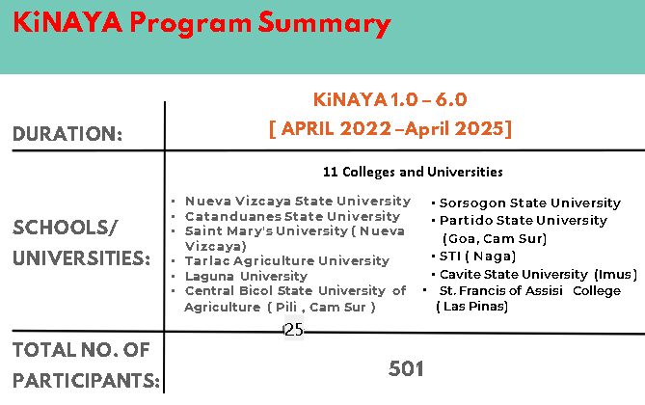

Slide 15


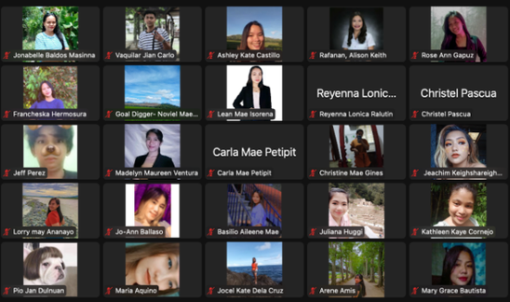
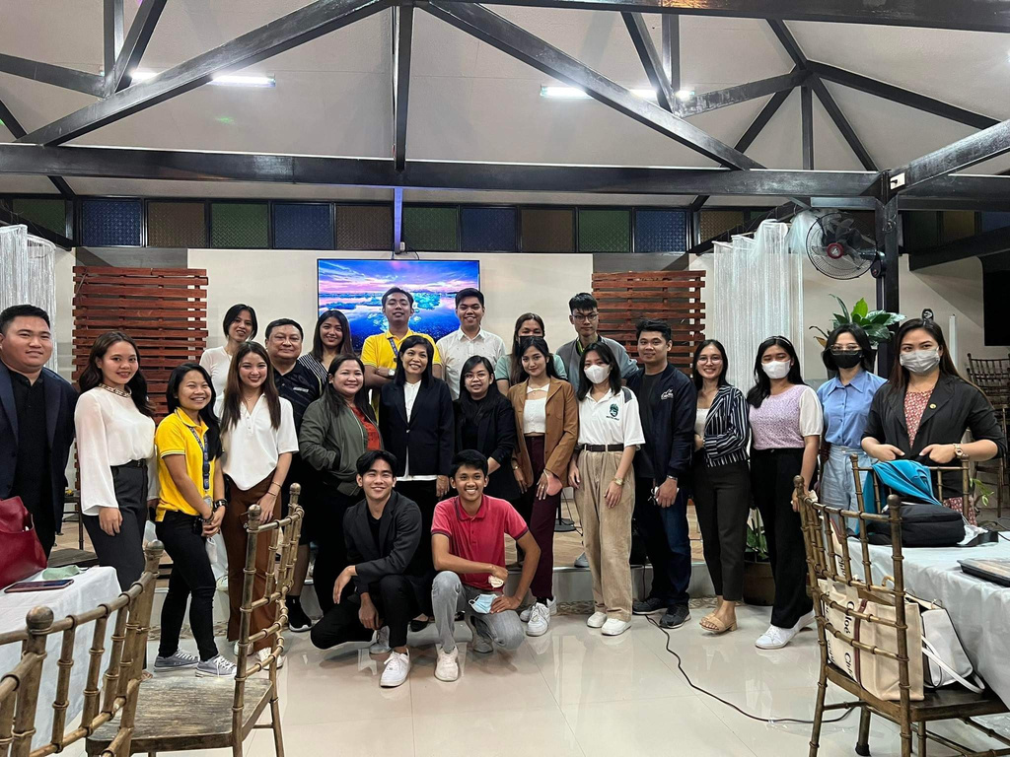
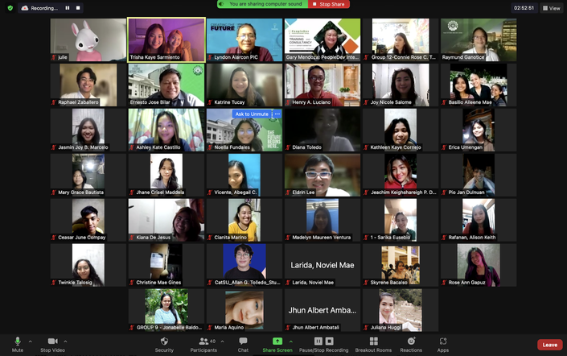


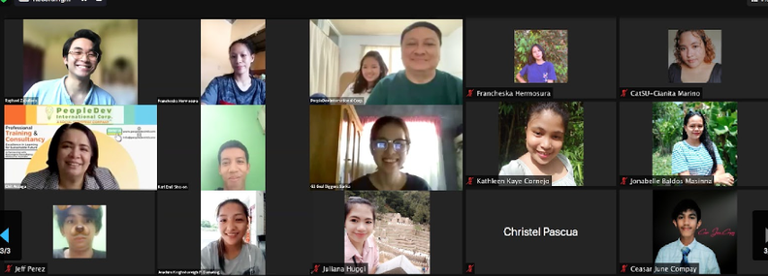
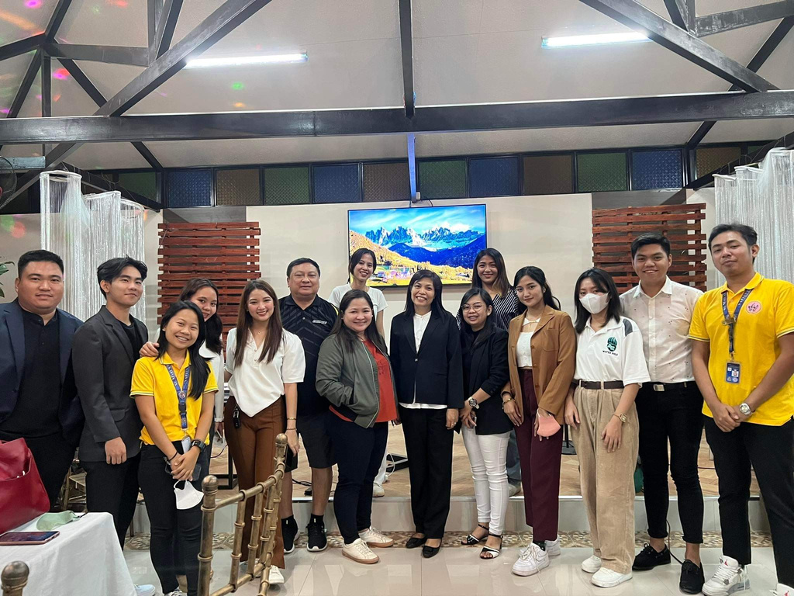
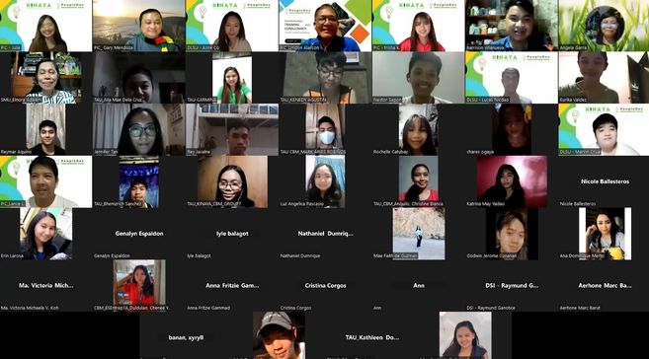
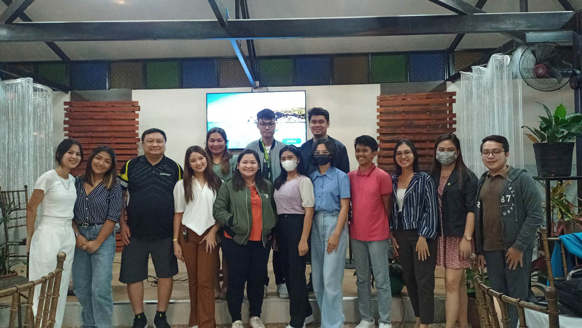
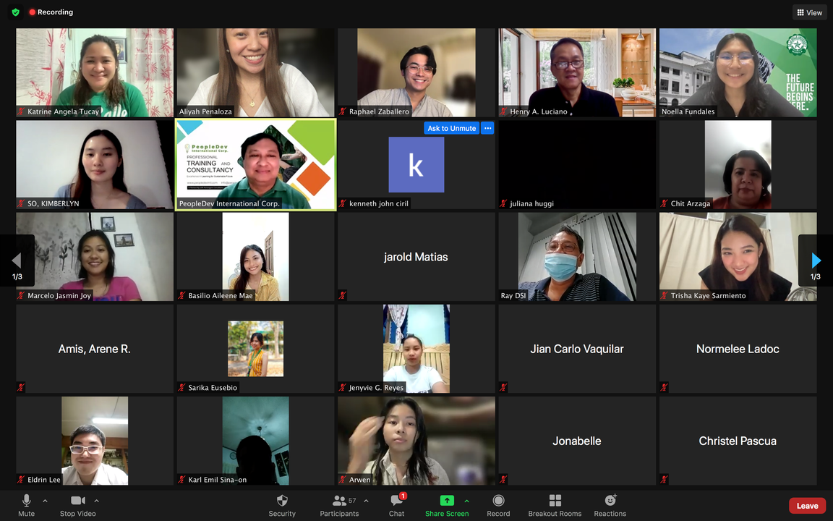
KiNAYA 1.0 & 2.0

Slide 16



For more information, visit:
https://www.peopledevintl.com/
https://www.facebook.com/PeopleDevIntl
For inquiries please email:
  Gary Mendoza- Chairman Emeritus
  lutgardo.mendoza@gmail.com
  Lyndon Alarcon – President:
lyndonalarcon64@gmail.com
  Kat Tucay – Entrep Dev. Director
katrinetucay@yahoo.com or katucay@nvsu.edu.ph
  Clare Gonzales – Digital Marketing/ Events Head
clareangelagonzales14@gmail.com

